Slide 1
FINAL AI/ML - MODEL

Slide 2
Model
The model we selected is Extreme Gradient Boosting Regression for predicting the arrival delay, which performs better than any other ML algorithm.
The features we have taken for training are ARR_TIME, 'ORIGIN', 'DEST', 'WHEELS_ON' &
The target feature is: 'ARR_DELAY'
The R-squared and adjusted R-squared values for training and testing sets are similar, and the mean Absolute errors are relatively low.
Overall, these measures suggest that the Extreme Gradient Boosting Regression model is performing well on both the training and testing sets and is not prone to overfitting or underfitting the data.

Slide 3
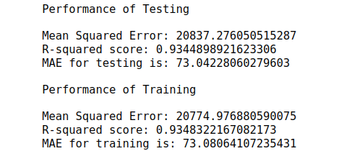
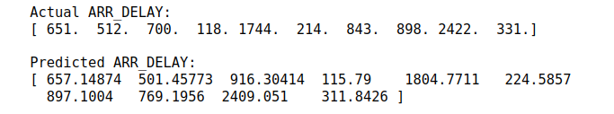
Model Performance :
Model Predictions

